Slide 1
Arrays
Fixed-Size Sequences of Elements
0
1
2
3
4
…
…
…
…
…
SoftUni Team
Technical Trainers
Software University
https://softuni.bg

Slide 2
Table of Contents
Arrays
Reading Arrays from the Console
Foreach Loop

Slide 3
Have a Question?
sli.do
#fund-csharp

Slide 4
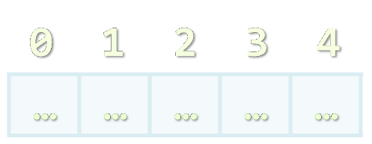
Working with Arrays of Elements
Arrays

Slide 5
What Are Arrays?
In programming, an array is a sequence of elements
Elements are numbered from 0 to Length-1
Elements are of the same type (e.g., integers)
Arrays have fixed size (Array.Length) and cannot be resized
0
1
2
3
4
Element index
Array of 5 elements
…
…
…
…
…
Element of an array

Slide 6
Creating Arrays
Use the new keyword
It is used to create the array and initialize the array elements to their default values
Allocating an array of 10 integers
An array that stores string elements can be declared in the same way
All elements are initially == 0
int[] numbers = new int[10];
All elements are initially == null
string[] names = new string[10];

Slide 7
Working with Arrays
Assigning values to the array elements
The Length holds the number of array elements
Accessing array elements by index
The [] operator accesses elements by index
for (int i = 0; i < numbers.Length; i++)
numbers[i] = 1;
numbers[5] = numbers[2] + numbers[7];
numbers[10] = 1; // IndexOutOfRangeException

Slide 8
Days of Week – Example
The days of week can be stored in array of strings
string[] days = {
"Monday",
"Tuesday",
"Wednesday",
"Thursday",
"Friday",
"Saturday",
"Sunday"
};
Operator | Notation in C#
days[0] | Monday
days[1] | Tuesday
days[2] | Wednesday
days[3] | Thursday
days[4] | Friday
days[5] | Saturday
days[6] | Sunday

Slide 9
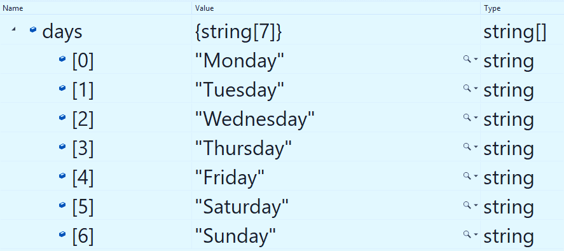
Problem: Day of Week
Enter a day number [1…7] and print the day name (in English) or "Invalid day!"
Check your solution here: https://judge.softuni.org/Contests/Practice/Index/1202#0

Slide 10
Solution: Day of Week
string[] days = { "Monday", "Tuesday", "Wednesday", "Thursday", "Friday", "Saturday", "Sunday" };
int day = int.Parse(Console.ReadLine());
if (day >= 1 && day <= 7)
Console.WriteLine(days[day - 1]);
else
Console.WriteLine("Invalid day!");
The first day in our array is on index 0, not 1.
Check your solution here: https://judge.softuni.org/Contests/Practice/Index/1202#0

Slide 11

Reading Arrays
Using a For Loop or string.Split()

Slide 12
Reading Arrays from the Console
First, read from the console the array's length
Next, create an array of given size n and read its elements
int n = int.Parse(Console.ReadLine());
int[] arr = new int[n];
for (int i = 0; i < n; i++) {
arr[i] = int.Parse(Console.ReadLine());
}

Slide 13
Reading Array Values from a Single Line
Arrays can be read from a single line of separated values
2 8 30 25 40 72 -2 44 56
Split() splits by space into string[]
string values = Console.ReadLine();
string[] items = values.Split();
int[] arr = new int[items.Length];
for (int i = 0; i < items.Length; i++)
arr[i] = int.Parse(items[i]);

Slide 14
Shorter: Reading Array from a Single Line
Read an array of integers:
uses System.LINQ;
var inputLine = Console.ReadLine();
string[] items = inputLine.Split(", ");
int[] arr = items.Select(int.Parse).ToArray();
Or shorter
int[] arr = Console.ReadLine().Split(", ")
.Select(int.Parse).ToArray();

Slide 15
Printing Arrays On the Console
To print all array elements, a for loop can be used
Separate elements with white space or a new line
string[] arr = {"one", "two"};
// == new string [2] {"one", "two"};
// Process all array elements
for (int index = 0; index < arr.Length; index++) {
// Print each element on a separate line
Console.WriteLine("arr[{0}] = {1}", index, arr[index]);
}

Slide 16
Problem: Print Numbers in Reverse Order
Read an array of integers (n lines of integers), reverse it and print its elements on a single line, space-separated:
4 -1
20
99
5
3
10
20
30
30 20 10
5 99 20 -1
Check your solution here: https://judge.softuni.org/Contests/Practice/Index/1202#1

Slide 17
Solution: Print Numbers in Reverse Order
// Read the array (n lines of integers)
var n = int.Parse(Console.ReadLine());
var arr = new int[n];
for (int i = 0; i < n; i++)
arr[i] = int.Parse(Console.ReadLine());
// Print the elements from the last to the first
for (int i = n-1; i >= 0; i--)
Console.Write(arr[i] + " ");
Console.WriteLine();
Check your solution here: https://judge.softuni.org/Contests/Practice/Index/1202#1

Slide 18
Problem: Rounding Numbers
Read an array of real numbers (space separated), round them in "away from 0" style and print the output as in the examples:
0.9 1.5 2.4 2.5 3.14
-5.01 -1.599 -2.5 -1.50 0
0.9 => 1
1.5 => 2
2.4 => 2
2.5 => 3
3.14 => 3
-5.01 => -5
-1.599 => -2
-2.5 => -3
-1.50 => -2
0 => 0
Check your solution here: https://judge.softuni.org/Contests/Practice/Index/1202#2

Slide 19
Solution: Rounding Numbers
Rounding turns each value to the nearest integer
double[] nums = Console.ReadLine().Split().Select(double.Parse).ToArray();
int[] roundedNums = new int[nums.Length];
for (int i = 0; i < nums.Length; i++) {
roundedNums[i] = (int)Math
.Round(nums[i], MidpointRounding.AwayFromZero);
}
// TODO: Print each number
2.5 => 3
Check your solution here: https://judge.softuni.org/Contests/Practice/Index/1202#2

Slide 20
Printing Arrays with for / string.Join(…)
Use for loop
Use string.Join(separator, array)
int[] arr = { 10, 20, 30, 40, 50};
for (int i = 0; i < arr.Length; i++)
Console.WriteLine(arr[i]);
int[] arr = { 1, 2, 3 };
Console.WriteLine(string.Join(", ", arr)); // 1, 2, 3
string[] strings = { "one", "two" };
Console.WriteLine(string.Join(" - ", strings)); // one - two

Slide 21
Problem: Reverse Array of Strings
Read an array of strings (space separated values), reverse it and print its elements:
Reversing array elements:
a b c d e
e d c b a
-1 hi ho w
w ho hi -1
exchange
a
b
c
d
e
Check your solution here: https://judge.softuni.org/Contests/Practice/Index/1202#3

Slide 22
Solution: Reverse Array of Strings
var items = Console.ReadLine().Split(' ').ToArray();
for (int i = 0; i < items.Length / 2; i++)
{
var oldElement = items[i];
items[i] = items[items.Length - 1 - i];
items[items.Length - 1 - i] = oldElement;
}
Console.WriteLine(string.Join(" ", items));
Check your solution here: https://judge.softuni.org/Contests/Practice/Index/1202#3

Slide 23

Iterate Through Collections
Foreach Loop

Slide 24
Foreach Loop
Iterates through all elements in a collection
Cannot access the current index
Read-only
foreach (var item in collection)
{
// Process the value here
}

Slide 25
Print an Array with Foreach
int[] numbers = { 1, 2, 3, 4, 5 };
foreach (int number in numbers)
{
Console.Write($"{number} ");
}
1 2 3 4 5

Slide 26

Summary
…
…
…
Arrays hold a sequence of elements
Elements are numbered from 0 to length-1
Creating (allocating) an array
Accessing array elements by index
Printing array elements

Slide 27
Questions?
Notes:
27

Slide 28














SoftUni Diamond Partners

Slide 29

Educational Partners

Slide 30
Trainings @ Software University (SoftUni)
Software University – High-Quality Education, Profession and Job for Software Developers
softuni.bg, about.softuni.bg
Software University Foundation
softuni.foundation
Software University @ Facebook
facebook.com/SoftwareUniversity
Software University Forums
forum.softuni.bg
Notes:
30

Slide 31

License
This course (slides, examples, demos, exercises, homework, documents, videos and other assets) is copyrighted content
Unauthorized copy, reproduction or use is illegal
© SoftUni – https://about.softuni.bg/
© Software University – https://softuni.bg
Notes:
31

